Slide 1
LIBRARY MANAGEMENT SYSTEM
BY
K.Prasanthi-24
M.Sukesh-34
Ch.Ani SRK-8
G.Bhargav-14

Slide 2
Project Objective:
The objective of this project is to create a user-friendly Online Library Management System that can store all the necessary member,student,issues,book and librarian information and enable them to retrieve it when needed. A library management system keeps track of the books present in the library.

Slide 3
Methodology:
Through this Online Library Management System , a practical approach has been taken under study to understand how it works.It will include all the necessary fields which are required during online Library Management system. This Online Library Management System will be easy to use.
Tools/Software:
Visual Studio(IDE),Python,MySQL

Slide 4
Outcomes:
Library Management System Software which enables the user to search for book and keep track on the books.It is providing all the functionality related to book publication.It tracks all the information and details of the book publication.

Slide 5
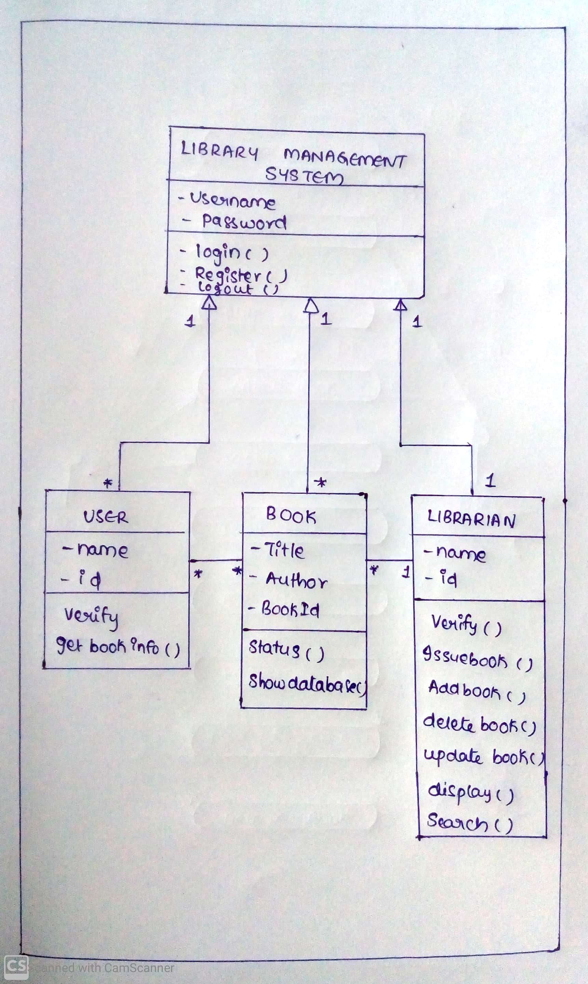
SYSTEM ARCHITECTURE:

Slide 6
Description of project files:
main.py – which does function call to all other python files
AddBook.py – To add the book
ViewBooks.py – To View the list of books in the library
DeleteBook.py – To Delete a book from library
IssueBook.py – To Issue a book from library
ReturnBook.py – To Return a book to the library

Slide 7
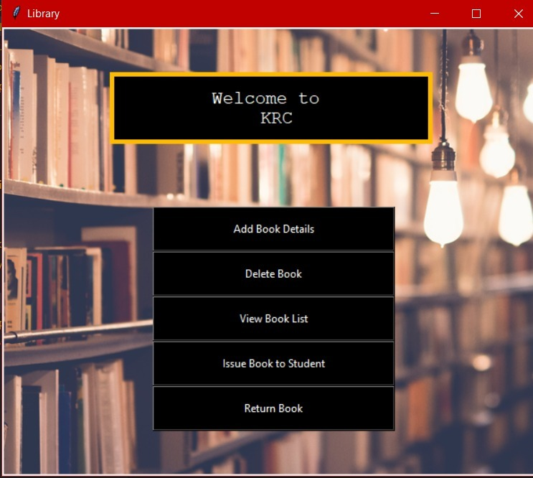
OUTPUT:

Slide 8
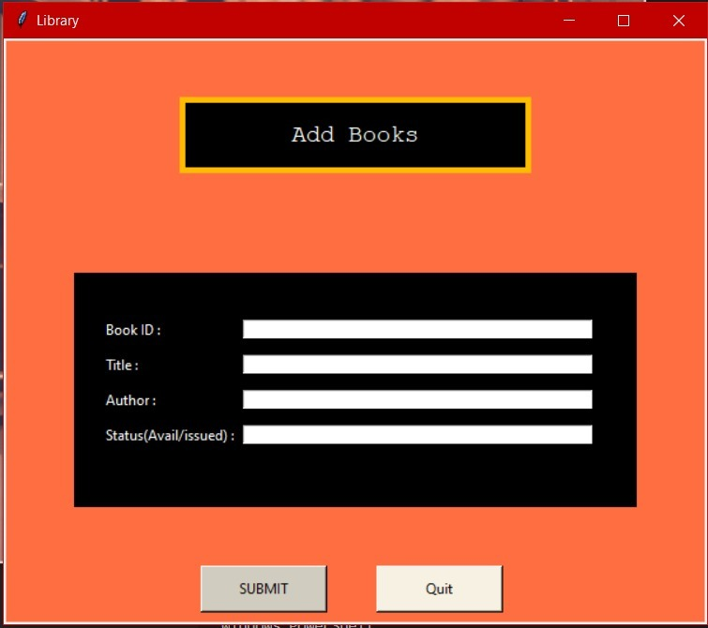
Add books:

Slide 9
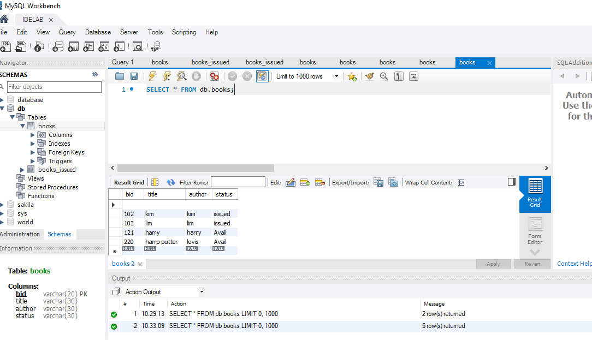

Slide 10
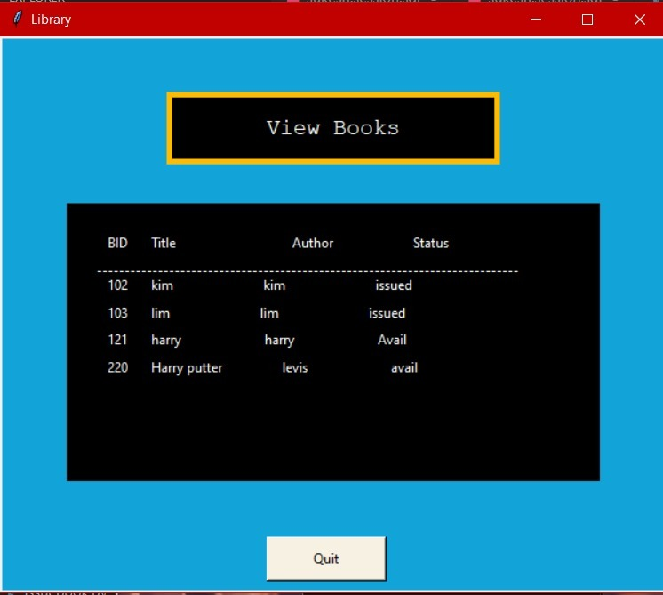
View Books:

Slide 11
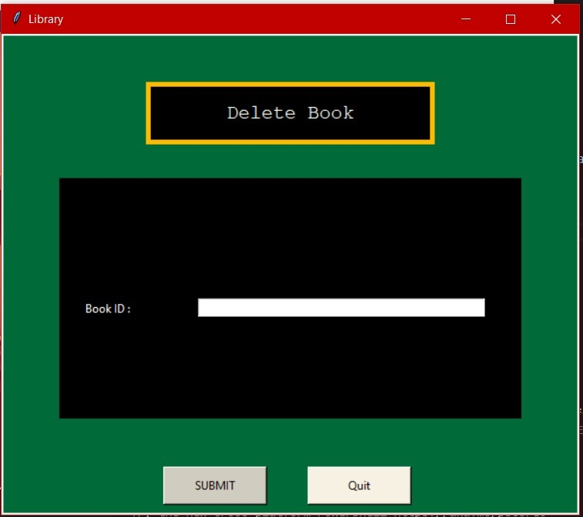
Delete Book:

Slide 12
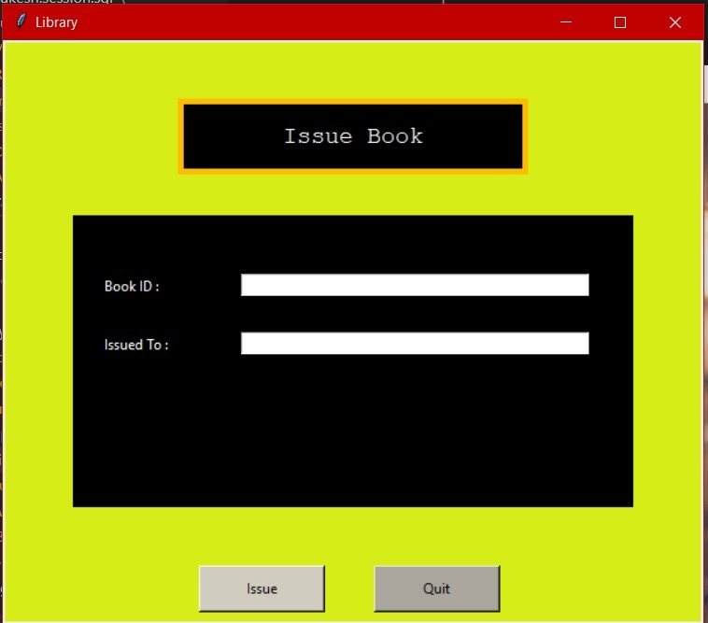
Issue Book:

Slide 13
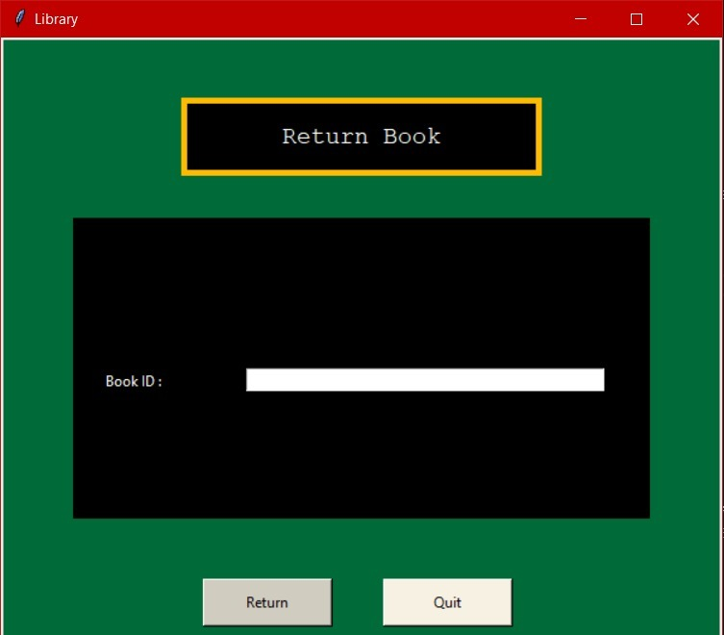
Return book:

